Slide 1
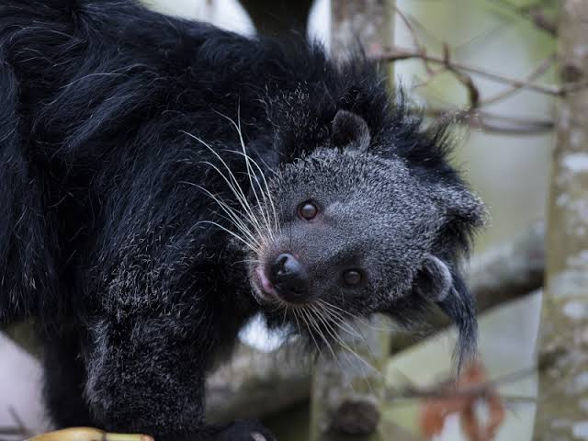
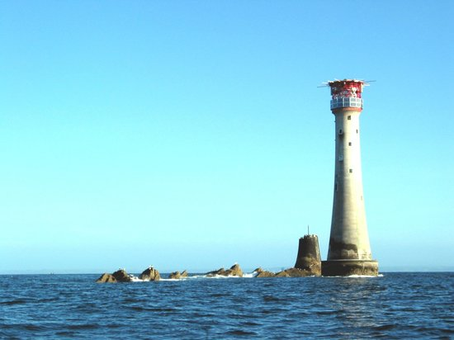
Welcome to Bearcat Class (aka Binturongs!)
The Class teachers are Mrs Daisy Broomfield on Monday, Tuesday and Friday,
and Mrs Gemma Banfield on Wednesday and Thursday.
Our Teaching Assistants are Mrs Vickers, Mrs Bond and Mrs Burns.

Slide 2
Our Curriculum
To find out about our learning please look on our class page on the school website. The curriculum map is on there to show all that we will be covering this Autumn alone!
We teach Maths and English every day except Fridays; some subjects, such as science, every week; and some like History and Geography in topic blocks.
Our first topic is a History topic about the nurses Florence Nightingale, Mary Seacole and Edith Cavell.

Slide 3
Home-Learning
As you may know, at Colerne we don’t set homework as such.
Home learning is to read their reading books, on a daily basis if possible. Later in the year we will send home spelling lists and we may ask for support practising number bonds or times tables too so the children can earn their star
badges.

Slide 4
Reading- your child will read with the teacher as part of a reading group once a week and again with a TA. Initially these books will be linked to their phonics learning and should be entirely decodable.
We will also read and share books together every day, practising our VIPERS skills. The more you are able to hear your child read at home the better- it really does make a huge difference. At this early stage, building their love of reading is just as important as building their skills, so it’s important it doesn’t become a chore! If they are struggling, it’s fine for you to read along together, to take it in turns to read a page each, or even for you to just read to them and ask them questions about the story. If they have a favourite book, it’s fine to read the same thing over and over again. It’s not a race through the levels, sometimes spending a bit longer on a level is really important for building confidence and fluency.

Slide 5
Up until Christmas we are focusing on our phonics skills with a daily half-hour session in school. After that, most year 2 children will move on to Spelling Shed and will then bring home spelling lists to learn, and these will be on the class website too. They may have a common spelling pattern or they may be the common exception words- words we use a lot that don’t sound out easily. If you can find a good moment in the day to practise these, again it really helps!

Slide 6
PE will take place on Mondays and Tuesdays.
On these days the children come into school wearing their PE kit which is a house-colour top, black shorts/jogging bottoms and trainers.
Our sports coach, Mr J, teaches the Monday morning session, and this term we will have cricket coaching on a Tuesday morning.

Slide 7
Snack: The children are given a healthy snack at morning break each day- usually a piece of fruit or a carrot. We encourage them to give it a try if they’re not sure, but they don’t have to have one if they’d rather not.
If you think your child is unlikely to want the school snack but might get hungry they can bring something from home but it does need to be healthy- no crisps/chocolate etc!

Slide 8
Our school ethos is based on the Bible quote
“Be a light for all to see!”
On Fridays we will award a Light of the Week
certificate to a child who has demonstrated one of our Light skills by being a -
Welcoming Light,
Shining Light,
Guiding Light,
or Leading Light
They will also bring home our bearcat mascot which they keep for a week and return to school the following Friday.

Slide 9
If you need to get in touch with us the best way is through Seesaw.
We will check it regularly and will try to reply the same day, either at lunchtime or after school.
It does get confusing with job shares but if you can try to send the message to the teacher who is working that day (or to both of us if appropriate) it really helps!
We will also use Seesaw to post messages and share the children’s work. The children can also use it to share a piece of work that they are proud of with you.

Slide 10
Have I missed anything?

